Slide 1

Machine learning approaches for Scheduling problem
FACULTY OF
ECONOMICS AND MANAGEMENT
Master Thesis Presentation
Name: Nga Nguyen – 221188
Email: nga1.nguyen@st.ovgu.de
Program: Operations Research and Business Analytics
Supervisor: Dr. Janis Sebastian Neufeld

Slide 2
AGENDA
01 Introduction to Scheduling problems and Machine Learning
02 Permutation Flow-shop Scheduling problem
03 Solution approach: Q-Learning
04 Experimental results
05 Conclusion and further research
Notes:
Here is the agenda. Firstly I’m giving an introduction to scheduling problems and machine learning, what are they and their different types. Secondly, I describe the problems that will be discussed in detail today, which is Permutation Flowshop scheduling problem. Then the method I use to solve the problem. Afterwards, is the experimental result from the application of the proposed method on different data sets. Final is conclusion and further research.

Slide 3
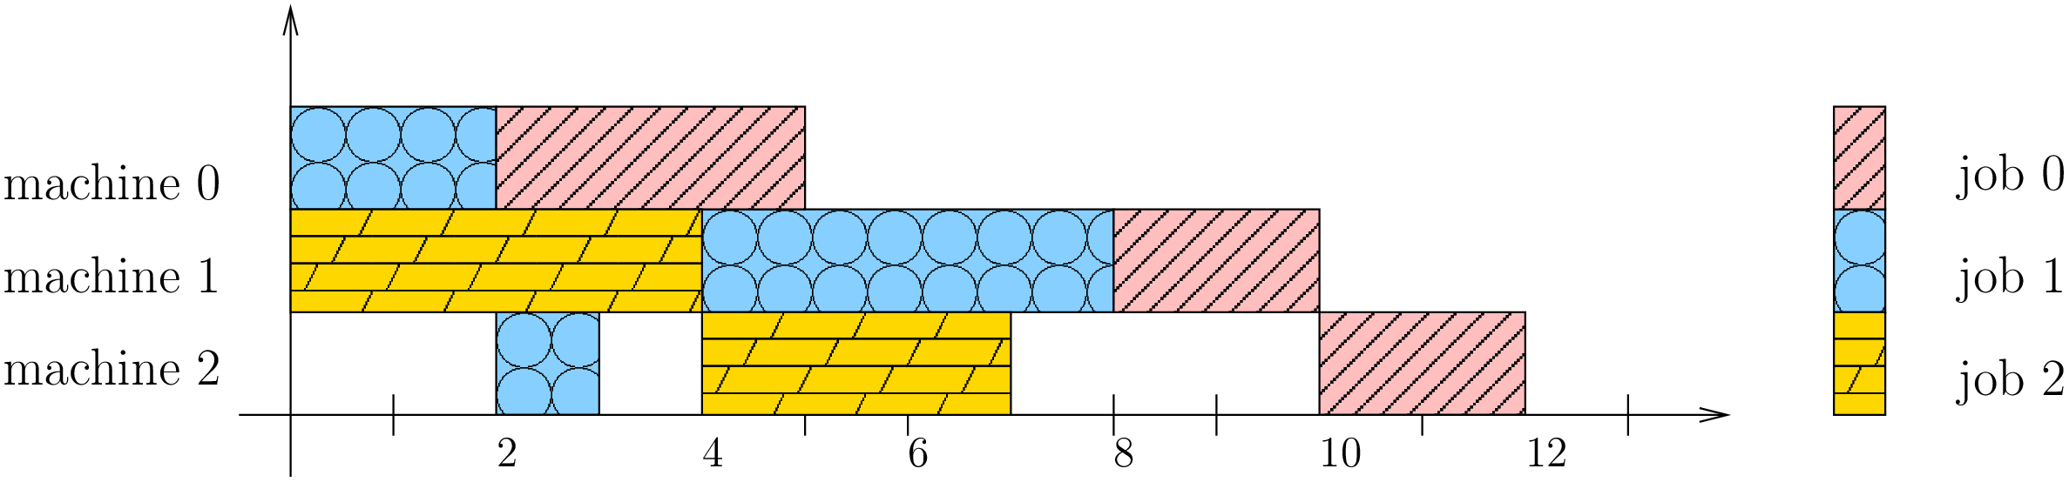
1. Introduction Scheduling Problems
Time required for each job in each machine
Scheduling is a decision-making process that is used on a regular basis in many manufacturing and service industries.
It deals with the allocation of jobs(i.e. the tasks in which each job is divided) to resources over given time periods. The goal is to optimize one or more objectives.
In manufacturing process:
Job: the item you wish to manufacture
Resources: Machines
Minimize production time and costs, by deciding when to make, with which staff, on which equipment.
 | Machine 0 | Machine 1 | Machine 2
Job 0 | 3 | 2 | 0
Job 1 | 2 | 4 | 4
Job 2 | 2 | 1 | 3
Makespan = 12
Source: Google OR tools
Notes:
Scheduling is a decision-making process that is used on a regular basis in many manufacturing and services industries.
what we have in this problem is a set of jobs that we have to complete and each of these jobs can be divided in a series of tasks or operations, that they have to be completed in a certain order.
and to do these tasks we have a set of resources, such as machines.
And the scheduling problem is how to allocate each of these tasks to the resources that we have.
And the goal is to optimize one or more objectives.
For example, on the right side, you can see a table with 3 jobs, and 3 machines. each of this job is divided into 3 tasks, which can be operated by each machine. And the value in the table is the time to finish one specific task in the machine.
The problem is to allocate the tasks in each machine in an order to minimize time.
The graph below shows one possible allocation, like machine 0 process job 1 first then job 0, And machine 1 process job 2 , then 1 and 0, and go on…As you can see, no machines can process more than 1 job at a time. And we have the time to finish all the jobs, which is called the makespan, here equal to 12

Slide 4
1. Introduction Different types of scheduling
Flow shop Scheduling Problem (FSSP)
Job shop Scheduling(JSSP)
Open shop Scheduling (OSSP)
All jobs have the same processing order through the machines.
The order of the jobs in each machine can be the same(permutation FSSP) or not necessarily the same(non-permutation FSSP)
Each job has its own routing
A given set of jobs is processed in an arbitrary order
Notes:
There are mainly 3 types of scheduling problems. First one is flowshop scheduling. Here all jobs have the same processing order through the machines.
The order of the jobs in each machine can be the same(permutation FSSP) or not necessarily the same(non-permutation FSSP)
The next type is Job shop scheduling, at which each job has its own routing.
And finally open shop scheduling, where a given set of jobs is processed in an arbitrary order.

Slide 5
1. Introduction Different types of scheduling
Flow shop Scheduling Problem (FSSP)
Job shop Scheduling(JSSP)
Open shop Scheduling (OSSP)
Every job must be processed in the same order:
Job 0: M0->M1->M2
The operations of a job can be processed in any order
Machine 0 -> Machine 1 -> Machine 2
Job 2: M1->M0-> M2
Job 3: M2->M1-> M0
 | Machine 0 | Machine 1 | Machine 2
Job 0 | 3 | 2 | 0
Job 1 | 2 | 4 | 4
Job 2 | 2 | 1 | 3
Notes:
For example with the data from previous slide
If each job must be processed in the same order, like from machine 0 to 1 to 2, then we are solving FSSP
If each job has its own routing, like job 0 must be processed from machine 0 to 1 to 2, and job 2 has a different route from M1 -0 -2, then the problem is Job shop scheduling problem
Then we have open shop, the tasks of a job can be processed in any order.

Slide 6
1. Introduction Scheduling Objectives
Flowtime:
Makespan:
Lateness:
Earliness-tardiness:
The sum of all jobs’ finishing times.
The maximum finishing time, which is the time when the last job is completed.
The difference between the due date and the finishing time. When this value is positive, it refers to tardiness, and when negative, the measure is earliness.
Sum of earliness and tardiness.
Notes:
In a scheduling problem, we always want to minimize or maximize something. Here are the 4 main objectives.
First is flowtime, which is the sum of all jobs’ finishing time
Next tis the makespan, which I introduced previously, is the maximum finishing time, when the last job is completed.
Next is lateness, which is the difference between duedate and the finishing time. When this value is positive, it refers to tardiness, and when negative, the measure is earliness.
Lastly, Earliness-tardiness is used to find the sequence, in which jobs are finished close to their due dates. When the jobs are too late or early, there may be punishment.
there are many approaches to solve scheduling problems, including heuristics, analytical, etc. and also machine learning, which has drawn a lot of attention recently.

Slide 7

1. Introduction Machine learning
“Machine Learning is the field of scientific study that concentrates on induction algorithms and on other algorithms that can be said to “learn.”” - Ron Kohavi (1998)
Machine learning algorithms build a model based on sample data, known as training data, in order to make predictions or decisions without explicitly programmed to do so - Arthur Samuel(1959)
Machine learning is considered as an optimization.
Application: automatic recommendation, personalized advertisements, object detection in videos and pictures, etc.
Notes:
So what is machine learning?
According to Ron Kohavi in 1998,….
According to Arthur Samuel ///
Machine learning is considered as an optimization. Optimization problems focus on finding optimal, or the best solution mathematically.
It has many applications, including automatic recommendation, personalized advertisements, object detection in videos and pictures, etc.

Slide 8
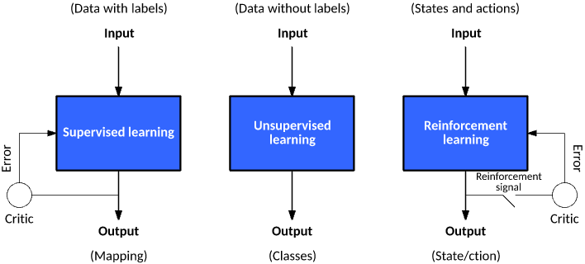
1. Introduction Types of Machine learning
Notes:
Mainly, there are 3 types of machine learning. Supervised, unsupervised and reinforcement learning.
The training data is always in the form of input/output pairs.
It Learn through training data to build a function, which is later used for mapping new examples
Common algorithms are Decision tree, Linear Regression, etc.
In unsupervised learning, The data is unlabeled. It is used to discover previously unknown patterns in the data
Common algorithms: K-means, Apriori, etc.
In reinforcement learning, we train a machine to understand the environment, through the process of trial and error, so it can take actions that maximize cumulative rewards.
Common algorithms: Q-learning, which will be described in later section

Slide 9
1. Introduction Literature review
The earliest work to be known used expert systems to solve scheduling problems (Kanet and Adelsberger, 1987). They proposed a reformulative approach, which focused on proactively restating the problem until a satisfactory solution is easy to be found
Haldun Aytug and Siddhartha (1994) presented a review of Machine Learning in Scheduling
Supervised learning | Reinforcement learning
Training examples must be generated from scheduling data. Then these examples are used to build a machine learning model. | Construct the algorithm directly from scheduling data
Shahzad and Mebarki (2012) generated training examples with an optimization module which solves instances base on tabu search Frank Benda [2019] generated training samples including different feasible solutions using constraint programming and mixed-integer programming | Gabel and Riedmiller (2007) use Reinforcement Learning for scheduling problems, more specifically job shop scheduling. Reyna, Jiménez, Cabrera and Hernández (2015,2017) followed the idea to solve JSSP and FSSP Reyna, Jiménez, Cabrera and Hernández (2019) proposed a new combination of RL, more specifically Q-Learning and a local search in order to give better solution.
Notes:
There are many research done to apply machine learning to scheduling problems.
The earliest work to be known used expert systems to solve scheduling problems (Kanet and Adelsberger, 1987). They proposed a reformulative approach, which focused on proactively restating the problem until a satisfactory solution is easy to be found
In 1994, Aytug and Siddhartha presented a review of Machine Learning in Scheduling. They proposed that systems that use human insights with heuristics have some promising advantages. Machine learning brings a way to combine both and apply to scheduling problems.
To the best of my knowledge, There are 2 ML approaches for this problem, first is to use Supervised learning. And to use supverised learning, training ,…. As Shazad and mebarki proposed a way in 2012. And in 2019 Frank Benda ….
Next is reinforcement learning, we construct the algorithm directly from data.
Gabel and Riedmiller (2007) use Reinforcement Learning for scheduling problems, more specifically job shop scheduling.
Reyna, Jiménez, Cabrera and Hernández (2015,2017) followed the idea to solve JSSP and FSSP and continuously improve it in 2019

Slide 10
2. Problem description Permutation flow shop Scheduling (P-FSSP)
A set of m machines and a set of n jobs
All jobs have the same processing order through machines
Each machine processes the jobs in the same order
Operations cannot be interrupted and each machine can process only one operation at a time.
=> find the job sequences on the machines that minimize the Makespan, which is the maximum completion time of all the operations.
n! feasible sequences
 | Machine 0 | Machine 1 | Machine 2
Job 0 | 3 | 2 | 0
Job 1 | 2 | 4 | 4
Job 2 | 2 | 1 | 3
Notes:
Now I will describe the main problem to be solved today, that is permutation flowshop scheduling
A set of m machines and a set of n jobs , like in the data we had, we have 3 machines and 3 jobs.
All jobs have the same processing order through machines, which means every job must be processed from machine 0 to machine 1, then machine 2
Each machine processes the jobs in the same order(, which mean if machine 0 process job 0, then 1, then 2, then machine 1 and 2 also process from job 0 1 and 2)
Operations cannot be interrupted and each machine can process only one operation at a time.
find the job sequences on the machines that minimize the Makespan, which is the maximum completion time of all the operations.
The feasible solutions can be job 0-job 1- job 2, or job 1 –job 0 – job 2
In total N! feasible sequences for this problem

Slide 11
2. Problem description Permutation flow shop Scheduling (P-FSSP)
Input:
A set of m machines and a set of n jobs
p(i,j) is the processing time of job i on machine j
Need to find:
A job permutation {J₁, J₂,…,J_{n}}
Objective:
Minimize C(J_{i}, j), the completion time of J_{i} on machine j is defined as follow:
 | Machine 0 | Machine 1 | Machine 2
Job 0 | 3 | 2 | 0
Job 1 | 2 | 4 | 4
Job 2 | 2 | 1 | 3
Feasible Sequence | Makespan
0-1-2 | 16
0-2-1 | 15
Etc. | …
C(J₁, 1) = p(J₁,1)
C(J_{i} , 1) = C(J_{i-1}, 1) +p(J_{i} ,1) for i = 2,…,n
C(J_{i}, 1) = C(J₁, j-1) +p(J₁,j) for j = 2,…,m
C(J_{i}, j) = max {C(J_{i-1} , j), C(J_{i} , j-1) + p(J_{i} , j) }
for i = 2,…,n ; for j = 2,…,m
C_{max} = C(J_{n},m)
Minimize!
Notes:
To formulate it, we have input as m machines and n jobs, p(I,j) is the processing time of job on machine j, which are the values in the up right table
And we need to find a job per mutation. J1 here means the first job to be processed, and J2 is the second job to be processed
The makespan is calculated as the formulation in the box. And it needs to be minimized
For example, from the previous data, when the job is processed in order 0-1-2, makespan is 16, and 15 when the order is 0-2-1

Slide 12
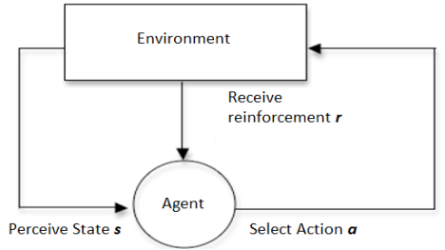
3. Q –Learning Definition
Q-Learning is a type of reinforcement learning
Q-Learning is a model-free algorithm
Q-Learning learns in an interactive environment by trial and error feedback
An agent
has a goal
is able to observe/monitor states
is able to perform actions that change its current state
Q-value
indicates the quality of a particular action a in a given state s : Q(s,a)
is current estimate of sum of future rewards
Q-table
Store Q-values
Has one row for each possible state, and one column for each possible action
Notes:
The method I proposed is Q learning.
Q-Learning is a type of reinforcement learning, just like other form of reinforcement learning, Q learning based system involved an AI agent operating in an environment, taking states and rewards as input to generate actions (output)
Q-Learning is a model-free algorithm:
The AI agent is not about learning an underlying mathematical model or probability distributions.
The AI agent attemps to construct an optimal policy directly by interacting with the environment.
Q-Learning does this by learns in an interactive environment by trial and error feedback:
The AI agent continuously updates its policy as it learns more about its environmentThe AI agent has a goal, which is to maximize the cumulative reward. It is able to observe and monitor states, and also able to perform actions that change its current state.
The agent learns about the environment by relying on and updating Q values. So… Q value indicates the quality of a particular action a in a given state s which we can represent as a function Q with two input parameters s and a.
since the Q stands for quality we can see that the AI agent is interested in identifying the highest quality action in any given State
When Q value increases, the AI gets closer to the highest reward.
Q table Stores Q-values
Has one row for each possible state, and one column for each possible action

Slide 13
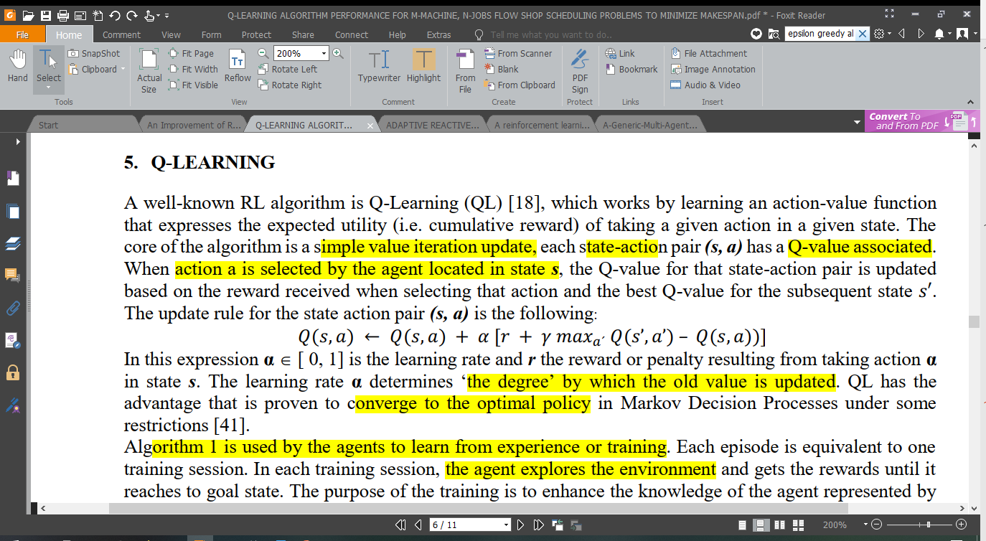
3. Q –Learning Definition
Randomly choose action
r < ε
Random number (r)
Actions will be chosen using an ε-greedy algorithm. This algorithm balances between exploration and exploitation. ε is set at the beginning.
When action a is selected by the agent located in state s, the Q-value for that state-action pair is updated based on the reward received when selecting that action and the best Q-value for the subsequent state
α ∈[ 0, 1] is the learning rate
𝛾 discount factor
r the reward resulting from taking action α
Max_{a’}Q(s’,a’) is the largest Q value for any action in the current state
r >= ε
Choose the best action
Notes:
The question is” Which action to choose?” Well.. Q learning will usally choose the most promising action, however, that can lead to the agent only exploits the previously chosen action, but not explores other new actions, which might give a better result. That’s when epsilon greedy algorithm comes in. We generate a random number, and if that number is larger than epsilon, we choose the best action base on Q value, and if smallers, we randomly choose action.
When action a is selected by the agent located in state s, the Q-value for that state-action pair is updated based on the reward received when selecting that action and the best Q-value for the subsequent state. The formula below is used to update Q value: …. It is also called a Bellman equation.
The learning rate α determines ‘the degree’ by which the old value is updated. With gamma is the discount factor, r is the reward

Slide 14
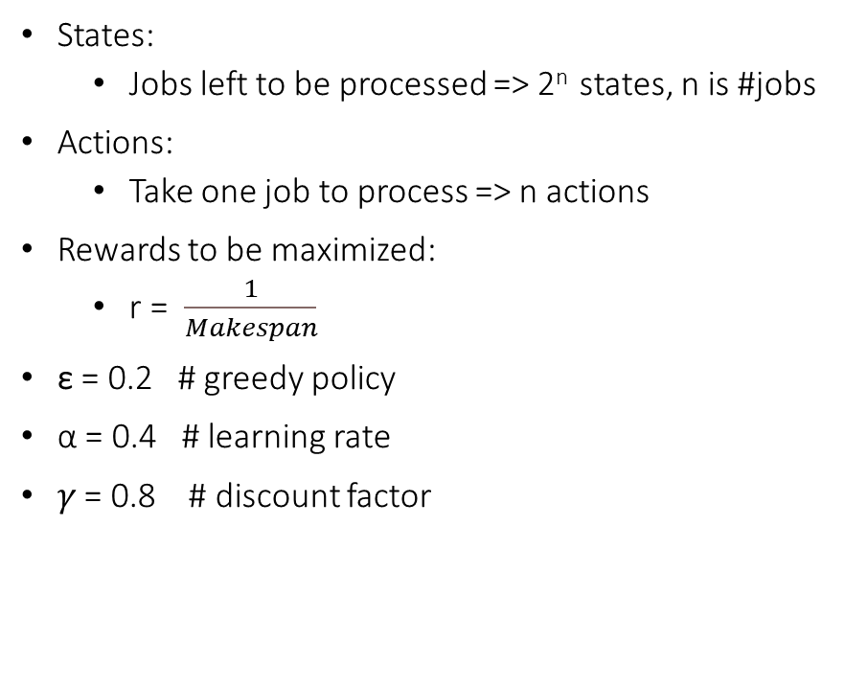
3. Q –Learning for P-FSSP Define Environment
 | Machine 0 | Machine 1 | Machine 2
Job 0 | 3 | 2 | 0
Job 1 | 2 | 4 | 4
Job 2 | 2 | 1 | 3
States:
Jobs left to be processed => 2^{n} states, n is #jobs
Actions:
Take one job to process => n actions
Rewards to be maximized:
r = $\frac{1}{Makespan}$
ε = 0.2 # greedy policy
α = 0.4 # learning rate
𝛾 = 0.8 # discount factor
_{States} ^{Actions} | Take Job 0 | Take Job 1 | Take Job 2
0,1,2 | 0 | 0 | 0
0,1 | 0 | 0
0,2 | 0 |  | 0
1,2 |  | 0 | 0
0 | 0
1 |  | 0
2 |  |  | 0
Ø
Notes:
Next we will see how to use Q learning for PFSSP
First step of Q learning is always define environment. States are jobs need to be processed. So there are 2^n states, with n is #jobs. For example, we have 3 jobs, which yields 8 states, you can see on the table on the right. On the first line, State 0,1,2 means at this state, we can choose to process job 0,1 or 2. And when we choose job 1 to process, we move to state 0,2
Action, is of course take one job to process.
In scheduling problem, we want to minimize the makespan, which means maximize 1/makespan, this is considered reward.
Then of course, we set epsilon = 0.2 for greedy policy, alpha and gamma.
In the table there are some black cells. Because when the agent is at that state, it’s not allows to take the action at black cell, like at state 0,1, the agent cant take job 2.
The last line is empty set, when we have no more jobs to process
Let’s start!

Slide 15
3. Q –Learning for P-FSSP Pseudo-code
Initialize :
Q(s,a) ={}
Best = {}
for each episode step do
Initialize s = {0,…,n}
while not_finished(all jobs)
Choose a from s using policy derived from Q(e.g., ε-greedy)
Take action a, observe state s' and r as 1/makespan(s’)
s ← s’
end while
if makespan(s) < makespan(Best):
Best ← s
end for
Notes:
I will give a quick explanation on the pseudo code. First we initialize Q value and best sequence as empty sets.
We run a for loop many times, the more times the more accurate the result.
Everytime a while loop runs, one job is done. While loop ends when no more jobs need to be processed.
In every state s, we use epsilon greedy to choose which action to process. Then we take action a, observe state s’, and calculate the reward.
Afterwards, we update Q value for the current state s and move to the next state.
Everytime all jobs are finished, we calculate the makespan and take the best makespan of all episodes, and the sequence which yields that makespan

Slide 16
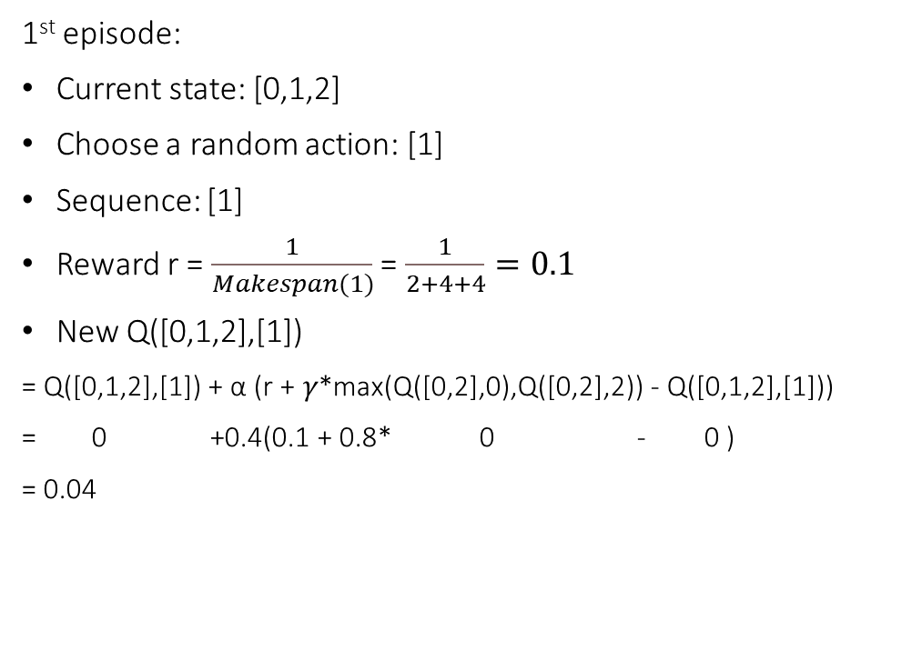
3. Q –Learning for P-FSSP Learning
 | Machine 0 | Machine 1 | Machine 2
Job 0 | 3 | 2 | 0
Job 1 | 2 | 4 | 4
Job 2 | 2 | 1 | 3
ε = 0.2
α = 0.4
𝛾 = 0.8
1st episode:
Current state: [0,1,2]
Choose a random action: [1]
Sequence: [1]
Reward r = $\frac{1}{Makespan(1)}$ = $\frac{1}{2+4+4}=0.1$
New Q([0,1,2],[1])
= Q([0,1,2],[1]) + α (r + 𝛾*max(Q([0,2],0),Q([0,2],2)) - Q([0,1,2],[1]))
= 0 +0.4(0.1 + 0.8* 0 - 0 )
= 0.04
_{States} ^{Actions} | Take Job 0 | Take Job 1 | Take Job 2
0,1,2 | 0 | 0 | 0
0,1 | 0 | 0
0,2 | 0 |  | 0
1,2 |  | 0 | 0
0 | 0
1 |  | 0
2 |  |  | 0
Ø
Notes:
Here is the implemenation
Now the agent is at state [0,1,2], because we haven’t processed any jobs yet.
Since all q values are 0, we choose a random action, and I chose job 1. Therefore the sequence up till now is job 1.
Rewards is 1 over the makespan of only job 1, which is 0.1
Then we update Q value of state [0,1,2] taking action 1 using updating formula.
New Q value = old Q value + alpha( reward + gamma * The largest Q value for any action in the next state, which is state [0,2] – old Q value)

Slide 17

3. Q –Learning for P-FSSP Learning
 | Machine 0 | Machine 1 | Machine 2
Job 0 | 3 | 2 | 0
Job 1 | 2 | 4 | 4
Job 2 | 2 | 1 | 3
ε = 0.2
α = 0.4
𝛾 = 0.8
1st episode:
Current state: [0,1,2]
Choose a random action: [1]
Sequence: [1]
Reward r = $\frac{1}{Makespan(1)}$ = $\frac{1}{2+4+4}=0.1$
New Q([0,1,2],[1])
= Q([0,1,2],[1]) + α (r + 𝛾*max(Q([0,2],0),Q([0,2],2)) - Q([0,1,2],[1]))
= 0 +0.4(0.1 + 0.8* 0 - 0 )
= 0.04
_{States} ^{Actions} | Take Job 0 | Take Job 1 | Take Job 2
0,1,2 | 0 | 0.04 | 0
0,1 | 0 | 0
0,2 | 0 |  | 0
1,2 |  | 0 | 0
0 | 0
1 |  | 0
2 |  |  | 0
Ø
Notes:
We update Q value in Q table

Slide 18
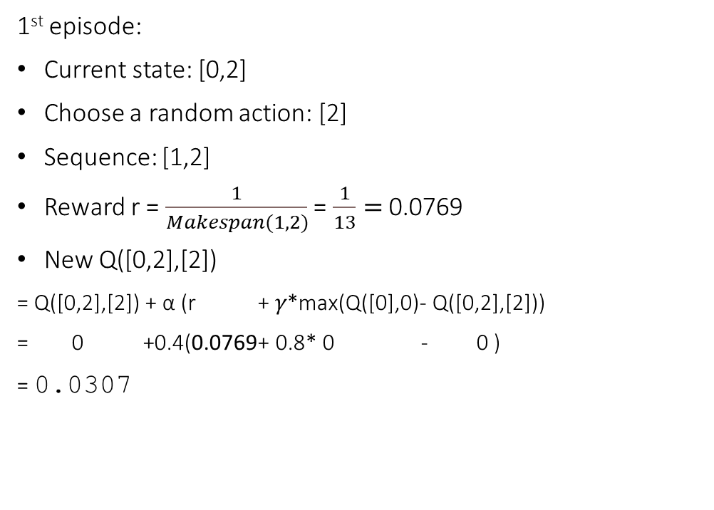
3. Q –Learning for P-FSSP Learning
 | Machine 0 | Machine 1 | Machine 2
Job 0 | 3 | 2 | 0
Job 1 | 2 | 4 | 4
Job 2 | 2 | 1 | 3
ε = 0.2
α = 0.4
𝛾 = 0.8
1st episode:
Current state: [0,2]
Choose a random action: [2]
Sequence: [1,2]
Reward r = $\frac{1}{Makespan(1,2)}$ = $\frac{1}{13}=$ 0.0769
New Q([0,2],[2])
= Q([0,2],[2]) + α (r + 𝛾*max(Q([0],0)- Q([0,2],[2]))
= 0 +0.4(0.0769+ 0.8* 0 - 0 )
= 0.0307
_{States} ^{Actions} | Take Job 0 | Take Job 1 | Take Job 2
0,1,2 | 0 | 0.04 | 0
0,1 | 0 | 0
0,2 | 0 |  | 0
1,2 |  | 0 | 0
0 | 0
1 |  | 0
2 |  |  | 0
Ø
Notes:
Now the agent is at state [0,2], because job 1 is processed.
Q values of the state when taking action 0 or 2 are both 0, we still choose a random action, which is 2. Therefore the sequence up till now is [1,2].
Rewards is 1 over the makespan of sequence [job 1, job 2] , which is 0.0769
Then we update Q value of state [0,2] taking action 2 using updating formula.

Slide 19
3. Q –Learning for P-FSSP Learning
 | Machine 0 | Machine 1 | Machine 2
Job 0 | 3 | 2 | 0
Job 1 | 2 | 4 | 4
Job 2 | 2 | 1 | 3
ε = 0.2
α = 0.4
𝛾 = 0.8
1st episode:
Current state: [0,2]
Choose a random action: [2]
Sequence: [1,2]
Reward r = $\frac{1}{Makespan(1,2)}$ = $\frac{1}{13}=$ 0.0769
New Q([0,2],[2])
= Q([0,2],[2]) + α (r + 𝛾*max(Q([0],0)- Q([0,2],[2]))
= 0 +0.4(0.0769+ 0.8* 0 - 0 )
= 0.0307
_{States} ^{Actions} | Take Job 0 | Take Job 1 | Take Job 2
0,1,2 | 0 | 0.04 | 0
0,1 | 0 | 0
0,2 | 0 |  | 0.0307
1,2 |  | 0 | 0
0 | 0
1 |  | 0
2 |  |  | 0
Ø
Notes:
We update Q_table

Slide 20

3. Q –Learning for P-FSSP Learning
 | Machine 0 | Machine 1 | Machine 2
Job 0 | 3 | 2 | 0
Job 1 | 2 | 4 | 4
Job 2 | 2 | 1 | 3
ε = 0.2
α = 0.4
𝛾 = 0.8
1st episode:
Current state: [0]
Choose a random action: [0]
Sequence: [1,2,0]
Reward r = $\frac{1}{Makespan(1,2,0)}$ = $\frac{1}{13}=$0.0769
New Q([0],[0])
= Q([0],[0]) + α ( r + 𝛾*max(Q([0],Ø)- Q([0],[0])
= 0 +0.4(0.0769+ 0.8* 0 - 0 )
= 0.0307
_{States} ^{Actions} | Take Job 0 | Take Job 1 | Take Job 2
0,1,2 | 0 | 0.04 | 0
0,1 | 0 | 0
0,2 | 0 |  | 0.0307
1,2 |  | 0 | 0
0 | 0
1 |  | 0
2 |  |  | 0
Ø
Notes:
Now the agent is at state [0], because job 1 and job 2 are processed.
At this state, we can only choose to take job 0
Rewards is 1 over the makespan of sequence [job 1, job 2,job 0] , which is 0.0769
Then we update Q value of state [0] taking action 2 using updating formula.

Slide 21
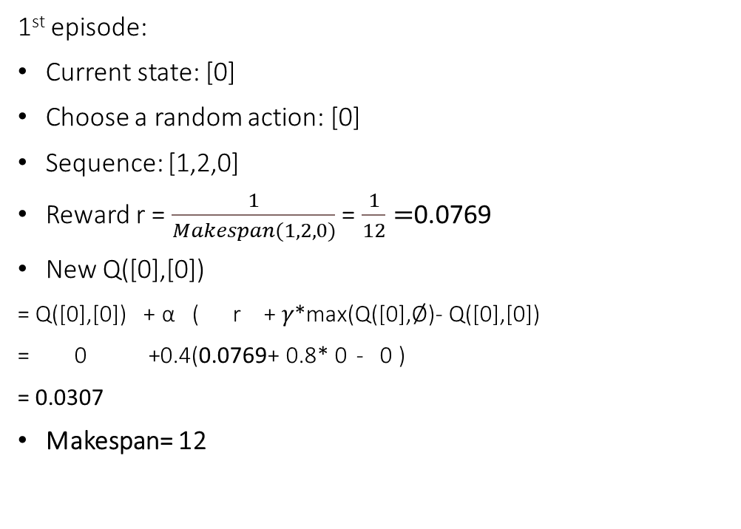
3. Q –Learning for P-FSSP Learning
 | Machine 0 | Machine 1 | Machine 2
Job 0 | 3 | 2 | 0
Job 1 | 2 | 4 | 4
Job 2 | 2 | 1 | 3
ε = 0.2
α = 0.4
𝛾 = 0.8
1st episode:
Current state: [0]
Choose a random action: [0]
Sequence: [1,2,0]
Reward r = $\frac{1}{Makespan(1,2,0)}$ = $\frac{1}{12}=$0.0769
New Q([0],[0])
= Q([0],[0]) + α ( r + 𝛾*max(Q([0],Ø)- Q([0],[0])
= 0 +0.4(0.0769+ 0.8* 0 - 0 )
= 0.0307
Makespan= 12
_{States} ^{Actions} | Take Job 0 | Take Job 1 | Take Job 2
0,1,2 | 0 | 0.04 | 0
0,1 | 0 | 0
0,2 | 0 |  | 0.0307
1,2 |  | 0 | 0
0 | 0.0307
1 |  | 0
2 |  |  | 0
Ø
Notes:
We update Q_table
After every episode, we get the makespan of a sequence of 3 jobs. After this episode, the makespan is 12
This makespan is used to find the best sequence of all episodes.

Slide 22
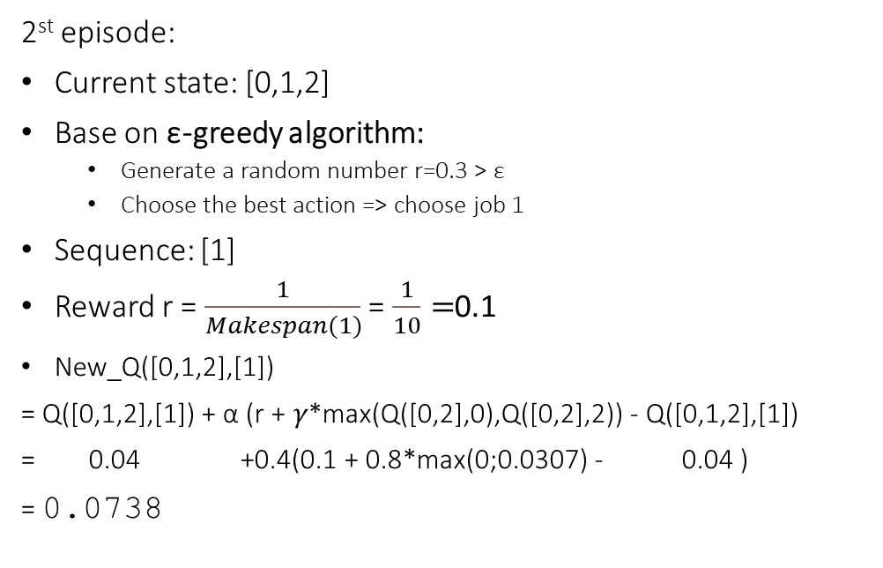
3. Q –Learning for P-FSSP Learning
 | Machine 0 | Machine 1 | Machine 2
Job 0 | 3 | 2 | 0
Job 1 | 2 | 4 | 4
Job 2 | 2 | 1 | 3
ε = 0.2
α = 0.4
𝛾 = 0.8
2st episode:
Current state: [0,1,2]
Base on ε-greedy algorithm:
Generate a random number r=0.3 > ε
Choose the best action => choose job 1
Sequence: [1]
Reward r = $\frac{1}{Makespan(1)}$ = $\frac{1}{10}=$0.1
New_Q([0,1,2],[1])
= Q([0,1,2],[1]) + α (r + 𝛾*max(Q([0,2],0),Q([0,2],2)) - Q([0,1,2],[1])
= 0.04 +0.4(0.1 + 0.8*max(0;0.0307) - 0.04 )
= 0.0738
_{States} ^{Actions} | Take Job 0 | Take Job 1 | Take Job 2
0,1,2 | 0 | 0.04 | 0
0,1 | 0 | 0
0,2 | 0 |  | 0.0307
1,2 |  | 0 | 0
0 | 0.0307
1 |  | 0
2 |  |  | 0
Ø
Notes:
Now we come to the second episode.
We are back at state [0,1,2] where no jobs are processed.
Which action should the agent take? Should it be job 1 because the Q value is largest? But what if there are better result if we take another job? This is problem of exploitation and exploration in Q learning. So we use epsilon greedy algorithm. We generate a random number, 0.3 and it’s bigger than the epsilon, then we choose the best action base on Q value, which is action 1. We calculate the reward and update Q value [0,1,2] taking action 1.
We update Q value, the formular is old q value, which is 0.04, + alpha which is 0.4 *(rewards + gamma(0.8)* max q value when the agent moves to state [0,2] which is q value of state [0,2] taking job 2 – old Q value)

Slide 23
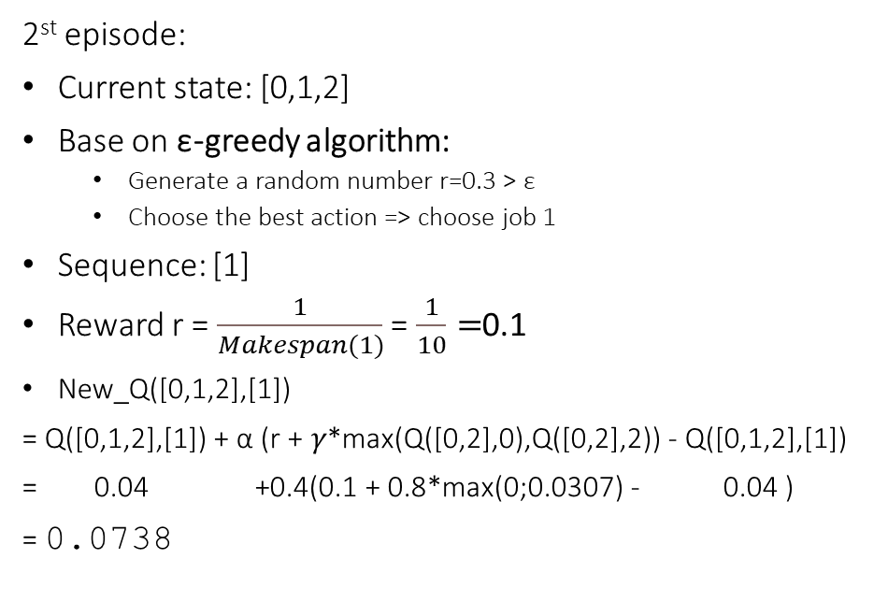
3. Q –Learning for P-FSSP Learning
 | Machine 0 | Machine 1 | Machine 2
Job 0 | 3 | 2 | 0
Job 1 | 2 | 4 | 4
Job 2 | 2 | 1 | 3
ε = 0.2
α = 0.4
𝛾 = 0.8
2st episode:
Current state: [0,1,2]
Base on ε-greedy algorithm:
Generate a random number r=0.3 > ε
Choose the best action => choose job 1
Sequence: [1]
Reward r = $\frac{1}{Makespan(1)}$ = $\frac{1}{10}=$0.1
New_Q([0,1,2],[1])
= Q([0,1,2],[1]) + α (r + 𝛾*max(Q([0,2],0),Q([0,2],2)) - Q([0,1,2],[1])
= 0.04 +0.4(0.1 + 0.8*max(0;0.0307) - 0.04 )
= 0.0738
_{States} ^{Actions} | Take Job 0 | Take Job 1 | Take Job 2
0,1,2 | 0 | 0.0738 | 0
0,1 | 0 | 0
0,2 | 0 |  | 0.0307
1,2 |  | 0 | 0
0 | 0.0307
1 |  | 0
2 |  |  | 0
Ø
Notes:
We update Q table. We repeat the process for a limited number of episodes, and get the best makespan during the process

Slide 24
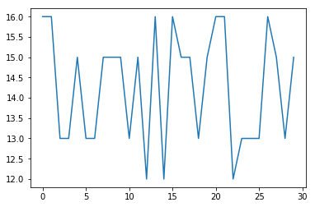
3. Q –Learning for P-FSSP Learning
 | Machine 0 | Machine 1 | Machine 2
Job 0 | 3 | 2 | 0
Job 1 | 2 | 4 | 4
Job 2 | 2 | 1 | 3
ε = 0.2
α = 0.4
𝛾 = 0.8
Makespan of each episode while learning
Makespan
Best sequence: 2-1-0
Best Makespan: 12
Episode
Notes:
Here I iterate 30 episode and this graph shows the make span of each episode. Then we get the best makespan is 12 and the best sequence is 2-1-0. In all the episodes, the makespan fluctuates, not become like flat overtime, because of the epsilon greedy alogirhtm. It also tries to explore other actions, not just the best action.

Slide 25
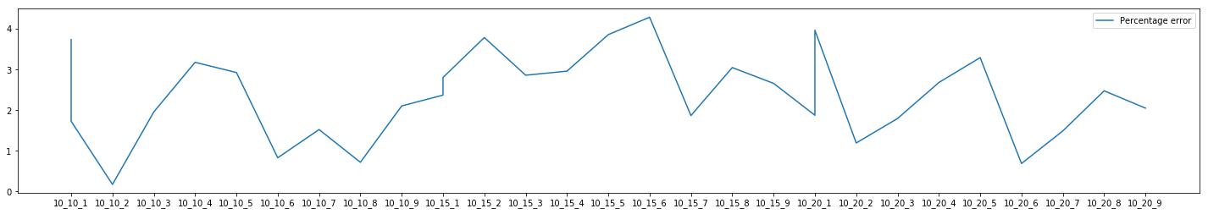
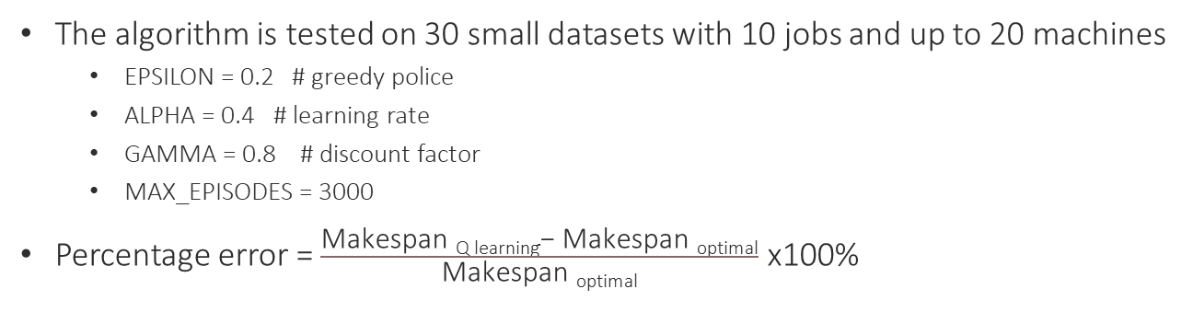
4. Experimental results
The algorithm is tested on 30 small datasets with 10 jobs and up to 20 machines
EPSILON = 0.2 # greedy police
ALPHA = 0.4 # learning rate
GAMMA = 0.8 # discount factor
MAX_EPISODES = 3000
Percentage error = $\frac{\text{Makespan} \text{Q} \text{learning}\text{− }\text{M}\text{akespan} \text{optimal}}{\text{Makespan} \text{optimal}}$ x100%
Instance | Optimal Solution | Q learning
10x10 | 1097 | 1138
10x15 | 1307 | 1338
10x20 | 1652 | 1683
Percentage error(%)
Data set (increase by size)
Notes:
The algorithm is tested on 30 small datasets with 10 jobs and up to 20 machines , using these parameters. Here I show 3 instances with different data size, and Q learning is able to find near optimal solution.
I also have a measure called percentage error to see how much Q learning result is different from the optimal sequence.
After testing on 30 datasets, the percentage error is just between 0 and 4 %.

Slide 26
5. Conclusion and Further research
Conclusion
The proposed method constitutes an interesting alternative to solve complex scheduling problems
This new approach gives a satisfactory solution
Further research
Application of the approach in other types of scheduling problems
The effect of parameters to the result
Apply the algorithm with bigger dataset
Compare with metaheuristics in terms of computational time and result

Slide 27
5. References
Yunior César Fonseca-Reyna (2019)- A reinforcement learning approach for scheduling problems (2015)
Yunior César Fonseca-Reyna(2017) An Improvement of Reinforcement Learning Approach for Permutation of Flow-Shop Scheduling Problems
Yunior César Fonseca-Reyna(2015) Q-learning algorithm performance for m-machine, n-jobs flow shop scheduling problems to minimize makespan
Frank Benda (2019) - A machine learning approach for flow shop scheduling problems with alternative resources, sequence-dependent setup times, and blocking
Haldun Aytug, Bhattacharyya (1994)- A Review of Machine Learning in Scheduling
Yailen Martínez Jiménez (2012)- A Generic Multi-Agent Reinforcement Learning Approach for Scheduling Problems
Tom Mitchell (1997) - Machine Learning

Slide 28
THANK YOU FOR YOUR ATTENTION

